Slide 1

Phone selling webpage system
By group 3 - SE1410
Lecturer: mr. Ho hoan kiem

Slide 2




Introduction
Group 3’s Members:
Hua Vinh Khang
Le Dat Anh Khoi
Dinh Nhu Hieu
Nguyen Duc Trung

Slide 3
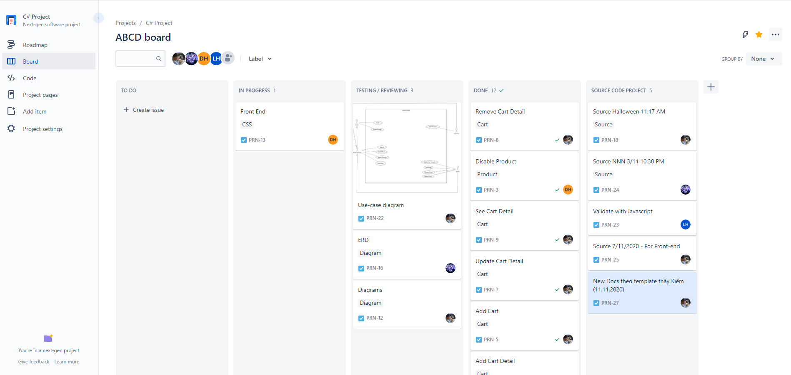
Introduction

Slide 4
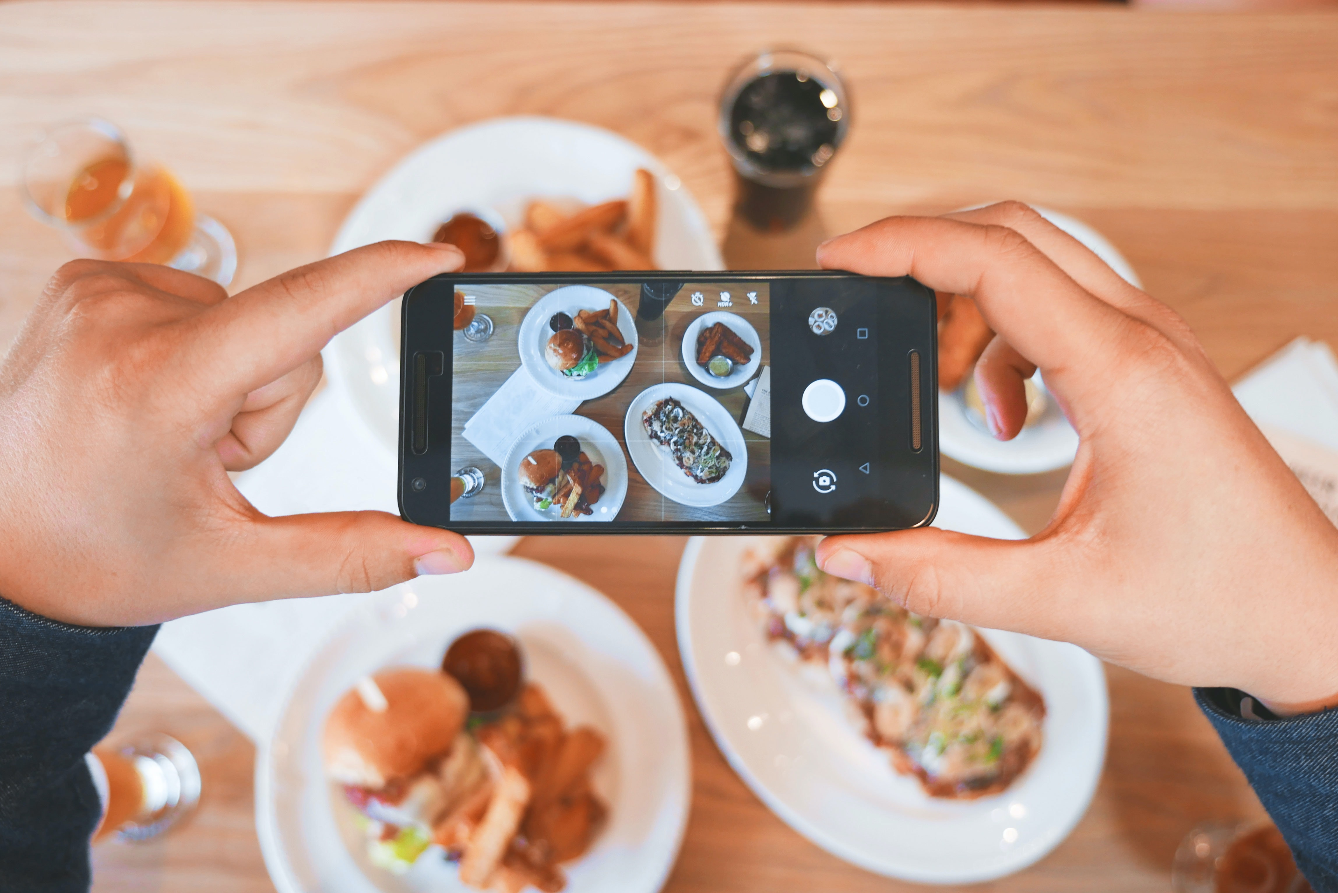
Overview
1. Purpose

Slide 5
OVERVIEW
Network
Browser
Microsoft SQL 2014
1I. Implementation

Slide 6
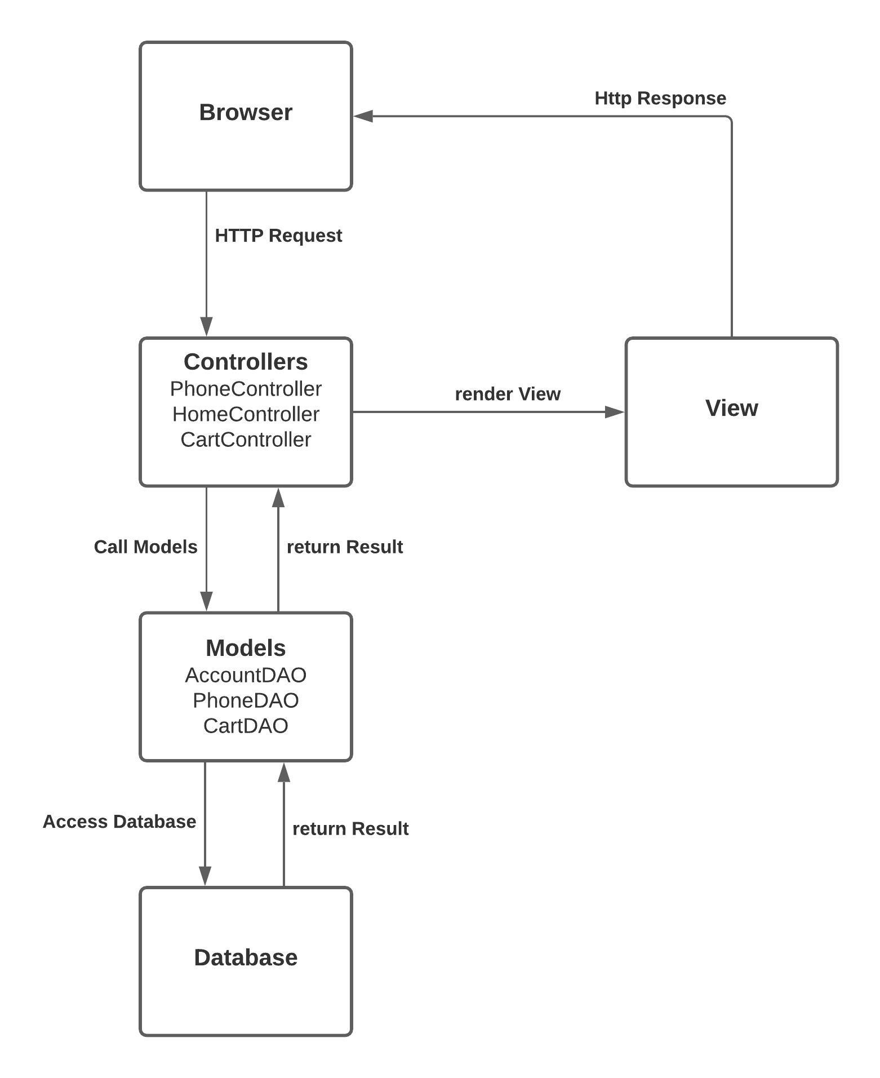
overview
III. MVC Model

Slide 7
In-app functions
Login – Logout
Register
Manage Accounts (Admin – Customer)
Show list devices
Search Devices (by Input Keywords, by Brand, by Category)
View device’s details
Manage Cart ( Add - Update – Remove - Confirm)
Track Orders ( as Admin & Customer)

Slide 8

Demo
Manage Account
Manage Product
Manage Cart & Track Orders

Slide 9

Q & A
Thank you for listening

